Slide 2
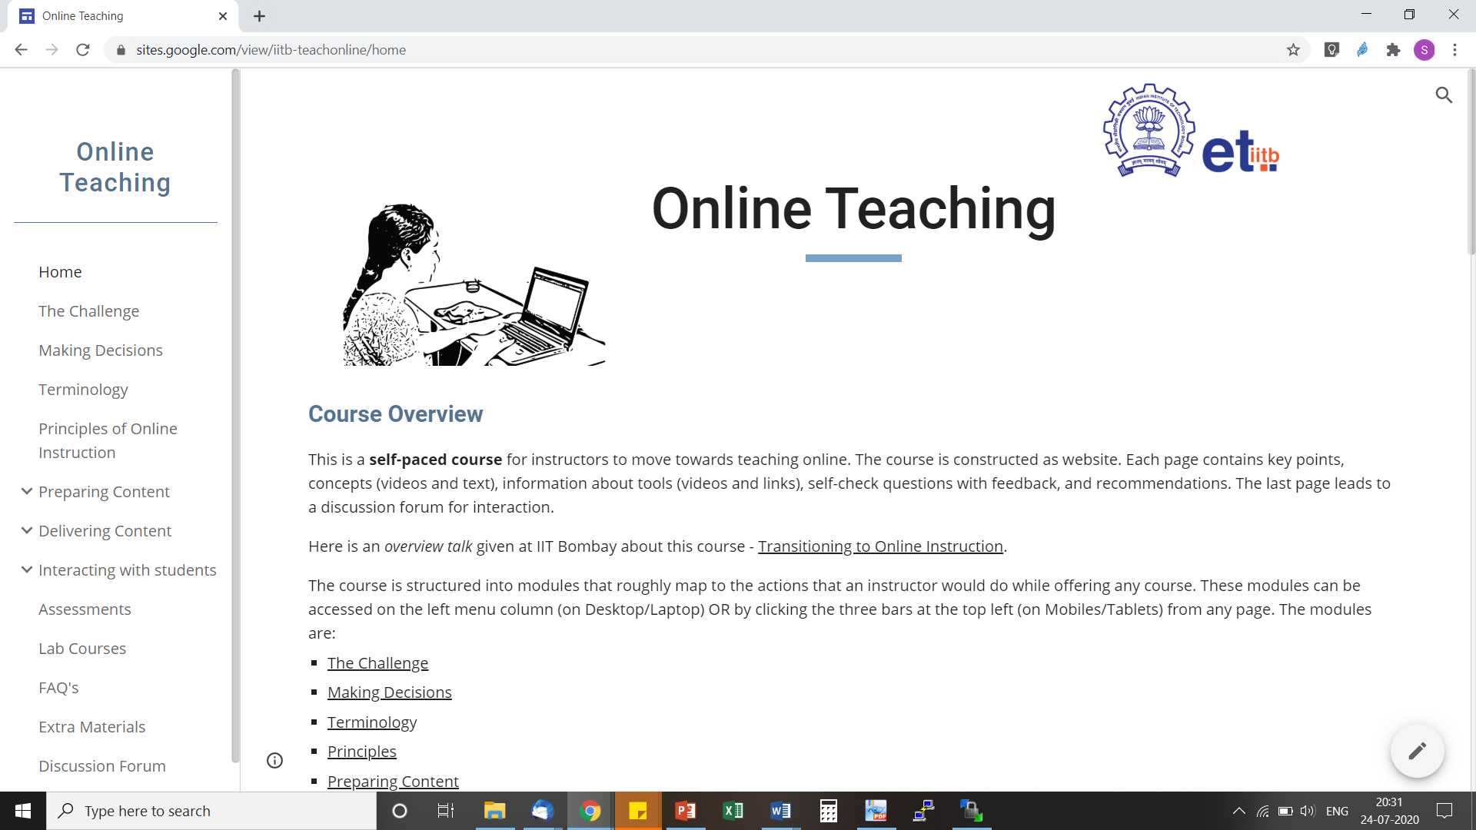
Basis and details related to this talk
Online Teaching Self-paced course developed at IIT Bombay
https://sites.google.com/view/iitb-teachonline/

Slide 3
Acknowledgements
Co-instructor of the course iitb-teachonline - Prof. Sridhar Iyer
TAs of iitb-teachonline – Ashutosh Raina and Lucian Ngeze
Organizer of TA training course - Pankaj Chavan
Co-creators of LCM model – Sridhar Iyer, Sameer Sahasrabudhe, Jayakrishnan M.
Post-docs on LCM – Gargi Banerjee, Veenita Shah, Mrinal Patwardhan
Tutorials on Tools – Yogendra Pal, Kameswari Chebrolu, P Sunthar, Bhaskaran Raman, Kannan Moudgalya, Santosh Noronha
TAs - Narasimha Swamy and other EdTech PhD students

Slide 4
Educational Technology, IIT Bombay
Inter-Disciplinary Program, started 2010
5 Core faculty
Associate faculty from other departments
2 Post-docs
25 PhD research Scholars; 16 PhDs graduated
Started an M.Tech program in 2019
See - www.et.iitb.ac.in

Slide 5
What we do in Educational Technology?
Adaptive and
Personalized
Tutoring Systems
Virtual Reality
Pedagogy & Technology for individual and collaborative learning
Augmented
Makerspace
MOOCs
Games
Learning environments
Eye Tracking
Analytics
Assessment

Slide 6
Online instruction

Slide 7
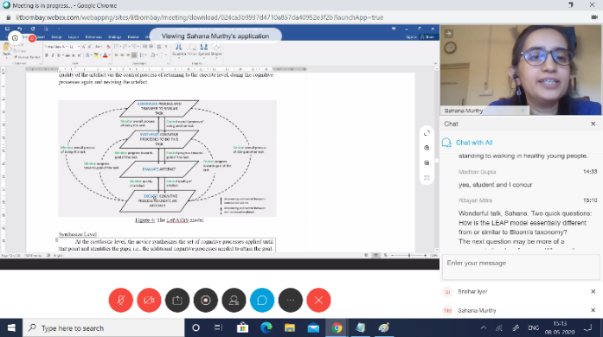
Face-to-Face vs Online classes
Course Materials
60%
70%
40%
30%

Slide 8
Activity 1 – Each one say one
Your colleague says that for online instruction it is sufficient to give live lectures over a video conferencing software (such as Zoom), record the lecture and upload it somewhere. Students who were unable to attend the lecture can view the recording.
What are some problems with this approach?
Post your response in the chat window.

Slide 9
What if we mimic f2f instruction in online mode?
What if we do:
Go to a virtual classroom (e.g. Zoom meeting)
Do a live lecture with students who are able to attend
Use the meeting software itself to record the lecture
Make the recording available to students who were not able to attend
Use Moodle to upload resources, give assignments, quizzes
Virtual classrooms
Recorded virtual classes
Notes:
Seems easy - learn to use the meeting software and to record one’s writing, if required.

Slide 10
Problems with virtual classrooms
Consider from students’ point of view
Access issues
No smartphone
Shared device
Lack of flexibility in schedule
Power, Network
Hour-long lecture, and over a screen – engagement?
Notes:
The connectivity, access and affordability for internet varies widely in our country.
Do not assume that students have the same access as you do, or that it is uniform for all students.
Conduct a survey for your class/institute and get to know your local context/reality.

Slide 11
Problems with recorded virtual classes
Uploading recordings of live sessions may be useful
Not sufficient because
Glitches in recordings (voice break, frozen frame) – lose student attention
Even short lectures (~10 min) are not watched fully by most; high variability in student motivation
Network bandwidth issues – connectivity, mobile data plan
Lecture alone not enough – need activities for deeper engagement
Notes:
There is a lot of data and studies to support the above points.
Highly motivated students will find ways to attend virtual classroom, persevere through glitches in recordings.
What percentage of your class falls in this category?

Slide 12
Emergency remote teaching
Give virtual lecture + Upload its recording + Provide assignments
is a form of emergency remote teaching (ERT)
Objective - provide temporary access to instruction and instructional material that is quick to set up and easy to access
This mode should be used sparingly, and in emergencies
(e.g. when the lockdown first hit)
Notes:
Use of remote teaching to deliver instruction that would otherwise be done face-to-face, is not wrong.
ERT is likely to be ineffective for student engagement and learning.

Slide 13
Problems with emergency remote teaching
Miss out on necessary aspects of “good” teaching
Interaction
with students
Adapting instruction in real-time
Responding to student actions
Meaningful discussion

Slide 14
Problems with emergency remote teaching
What if we do:
Go to a virtual classroom (e.g. Zoom meeting)
Do a live lecture with students who are able to attend
Use the meeting software itself to record the lecture
Make the recording available to students who were not able to attend
Use Moodle to upload resources, give assignments, quizzes
Focus is on
Technology and tools

Slide 15
What makes online instruction effective?
Focus on
Technology and tools
Effective Online Instruction
Strategies and Practices of Online Teaching

Slide 16
Online instruction
The goal is to exploit the power of the online medium and utilize it to promote effective student learning
Notes:
Attempting to mimic classroom actions in the online medium is not the goal.

Slide 17
Activity 2 – Identify your concerns
Which aspects of online instruction do you think will make the execution of the course in online mode challenging for you?
Tick all the that apply.
Making videos
Time required to prepare for each class
Using the online platform (like Moodle features)
Doing online assessments
Interacting with students synchronously (like Zoom meetings)
Having to use technologies in general
Uncertainty of technology support from institute
Go to www.menti.com and use the code 77 10 15

Slide 18
What does Online Instruction involve?
Content creation or curation
Upload & share content
Design activities, provide
resources
Interact with students
Assess- ment

Slide 19
Concepts overview
LeD
Six principles
LbD
LxI
One slide on each
Notes:
Principles are not sacrosanct. They are recommendations for effective student learning.
Some terminology will be introduced. Please refer www.lcm-model.org for details.

Slide 20
Principle #1
Curate before you create
Notes:
There is a lot of good content already available. Don’t re-invent, instead re-purpose.

Slide 21
Principle #2
Keep videos short,
and insert reflection spots
Notes:
Don’t do long lectures. Instead chunk them into multiple LeD.

Slide 22
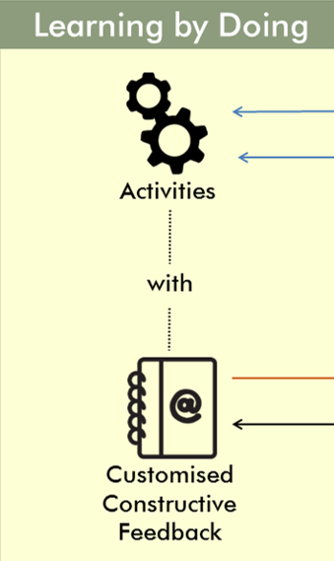
Principle #3
Give practice opportunity,
immediately and frequently,
and give feedback
MCQs, short answer
Objective/Subjective
Notes:
Split your homework into a few chunks, corresponding to your LeDs.

Slide 23
Principle #4
Provide diverse resources to cater to different students,
and incentivize the access to resources
Notes:
Give an explanation

Slide 24
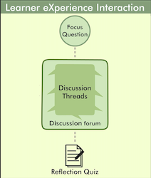
Principle #5
Leverage peer-learning,
to bring in diverse perspectives and solutions,
discover additional resources,
and avoid isolation issues
Notes:
Give an example here

Slide 25
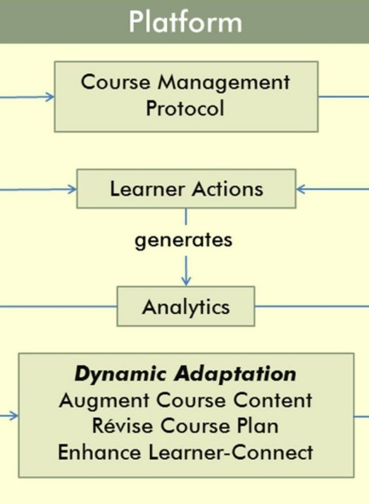
Principle #6
Respond to student actions, in a timely and appropriate manner
Notes:
See how they are doing in the course, what they are saying in the discussion forums.
Adapt instruction, Recognize participation.

Slide 26
Online instruction involves
Making course materials available for asynchronous access
Giving immediate practice activities and timely feedback to students
Conducting synchronous meetings to address queries and do tutorials
Providing a forum for learners to discuss the content with each other and the instructor
Course Materials

Slide 27
Tasks / aspects in online teaching
Content creation or curation
Upload & share content
Design activities, provide
resources
Interact with students
Assess- ment

Slide 28
Technology Tools: Content Creation

Slide 29
Content creation involves
Content creation or curation
1
2
3
Video recording
Video editing
Planning of Video recording
Preparing content, e.g. PPT/PDF presentation
Identifying chunks
Deciding video format

Slide 30
Activity 3 - Quick poll
Specific to your course:
In which of the following ways you will be mostly required to teach the course topics in online mode?
Presentation using slides
Looking at learners
Writing/Sketching on a Digital Whiteboard
Presenting while looking at the learners
Writing/Sketching while looking at learners
Some combinations of the above options
Go to www.menti.com and use the code 77 10 15

Slide 31
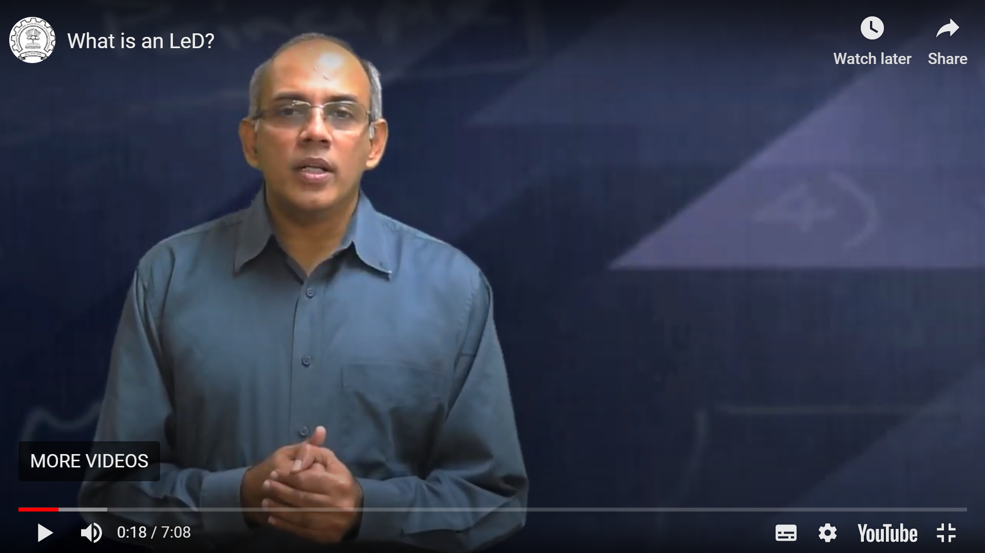
Recommended formats for videos
Presentation using slides: Slidecast
Looking at learners:
Talking Head

Slide 32
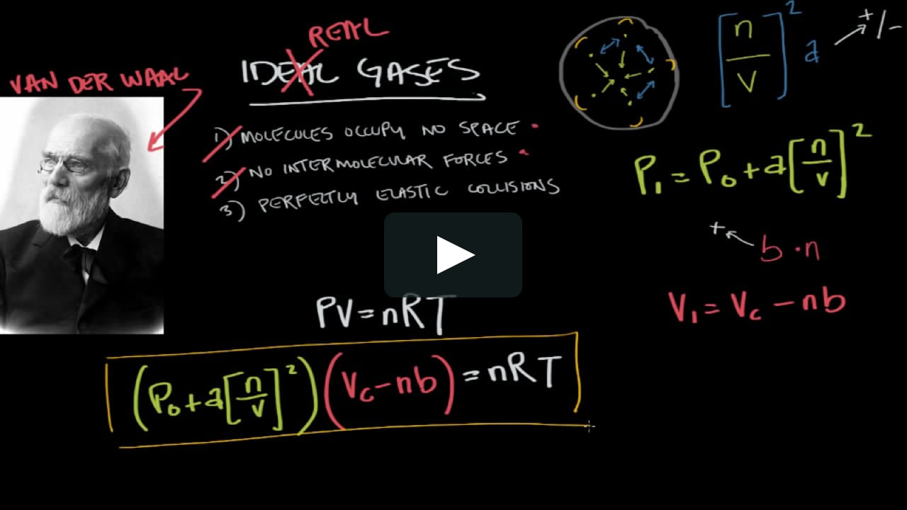
Recommended formats for videos
Writing on a Digital Whiteboard:
Screencast
Presenting while looking at the learners: Pic in Pic

Slide 33
Recommended formats for videos
Writing while looking at learners: Pic in Pic
Talking head → Screencast → Pic in Pic: Transitions
Instructor

Slide 34
Video recording involves
Content creation or curation
1
2
3
Video recording
Video editing
Planning of Video recording
Identifying resources - hw & sw
Selection of video recording tool/software
Recording

Slide 35
Summary - Video format and resources
Video format | Resources (Hardware + Software) | Video Type
Presentation using slides | Laptop (Audio) + PPT File | Slidecast
Looking at learners | Camera Laptop (Webcam + Audio) | Talking Head
Writing on a Digital Whiteboard | IPad Screen + Writing Software Laptop (Audio) + Writing Software | Screencast
Presenting while looking at learners | Laptop (Webcam + Audio) + PPT File | Picture in Picture
Writing while looking at learners | Laptop (Webcam + Audio) + Writing Software IPad (Screen + Webcam) | Picture in Picture
Notes:
This is a summary

Slide 36
Video recording tools/software
Slidecast/Screencast
Screen recorder - Xbox Game Bar, FlashBack Express, QuickTime player (Mac), RecordMyDekstop (Linux)
Talking head
Webcam, Smartphone, Tablet
Pic in Pic
Screen recorder - FlashBack Express, Screencast-o-matic
Transitions - Talking head → Screencast → Pic in Pic
Lot of post processing - Trimming, Joining, Removing unwanted pieces
OBS (Open Broadcaster Software) Studio
Notes:
This is for infomation

Slide 37
Video editing involves
Content creation or curation
1
2
3
Video recording
Video editing
Planning of Video recording
Trim, Slice or Merge
Add/Remove pauses
Add/Remove graphics, transitions
Insert in-video activities
Export videos

Slide 38
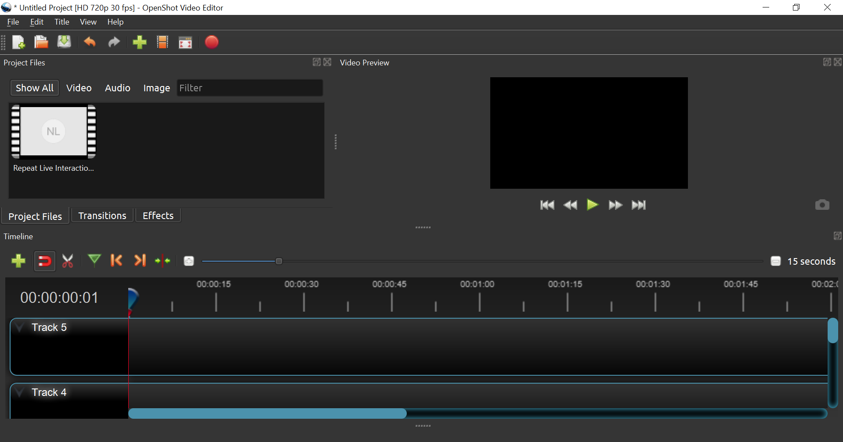
Video editing -(e.g. OpenShot)
- Trim, Slice, Merge - Add/ remove pauses - Add/ remove graphics - Include transitions - Export videos
Video Preview
Drag and drop
Tools
Timeline

Slide 39
Insert in-video activities / quizzes (e.g. using H5P)
Why?
Make videos interactive
Engage students in content
Quick practice & check within video
How?
Use tool like H5P during editing
Or use slide during recording and ask students to pause
Terminology
Reflection Spot (in video activity)
Learning Dialogs (interactive video)

Slide 40
Technology Tools: Uploading & Sharing

Slide 41
Uploading and sharing content involves
Content creation or curation
Upload & share content
Design activities, provide
resources
Interact with students
Assess- ment
Identifying video hosting platform
Identifying sharing platform

Slide 42
Quick clean & upload
Trim the video, chunk if required, remove any long pauses
Export videos; compress if required (Handbrake)
Upload on video hosting platforms like YouTube:
Public vs Unlisted vs Private

Slide 43
Sharing content
Sharing platform: Moodle or other LMS, Google Sites, BodhiTree, …..
Embed videos from Youtube, Vimeo
Write wrappers
Embed quizzes / activities
Notes:
Some sharing platforms - Vimeo - No Ads - No distraction

Slide 44
Technology Tools: Creating activities

Slide 45
Creating activities involves
Content creation or curation
Upload & share content
Design activities, provide
resources
Interact with students
Assess- ment
Creating activities for immediate and frequent practice
Providing feedback on student responses
Providing diverse resources

Slide 46
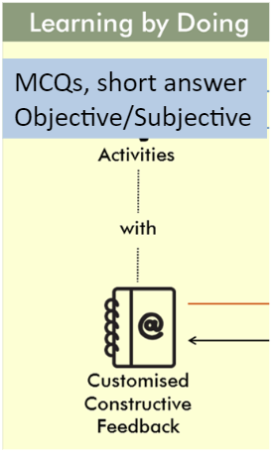
Learning by Doing (LbD) activities
Recommendations
Don’t push all LbD activities to the end to module
Intersperse them between videos
Give feedback -
Customized to MCQ options
Using rubrics for long answers, problems

Slide 47
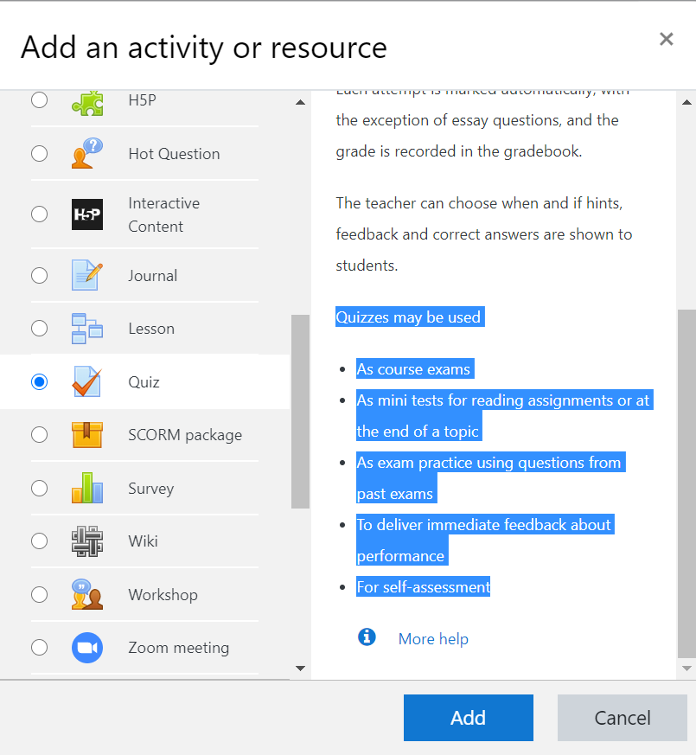
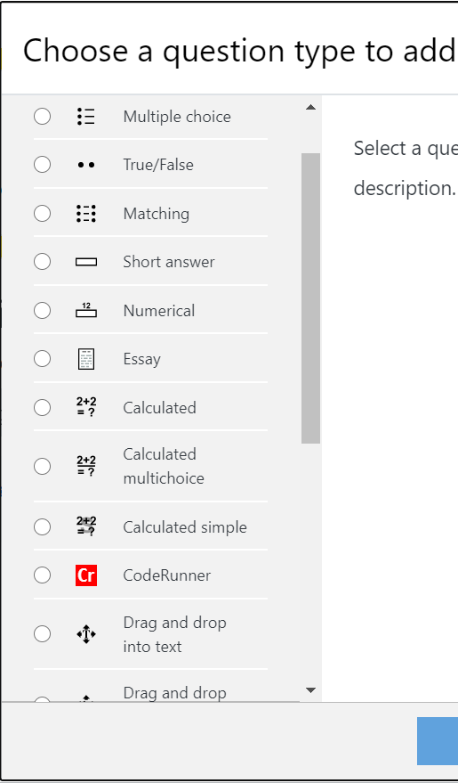
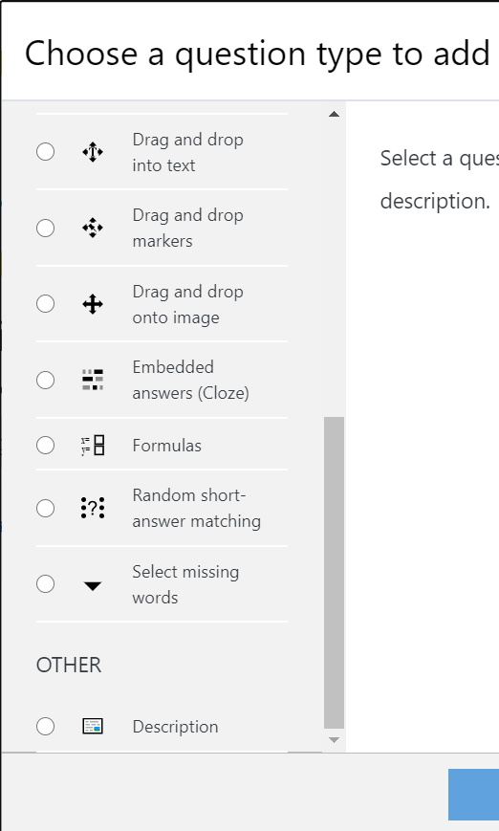
LbD Activities on Moodle - Example
Notes:
Types of LbD activities - After every LeD - Demo - E.g. LCM MOOC
Multiple Choice Quizzes
Short Answer Questions
Open Ended Questions

Slide 48
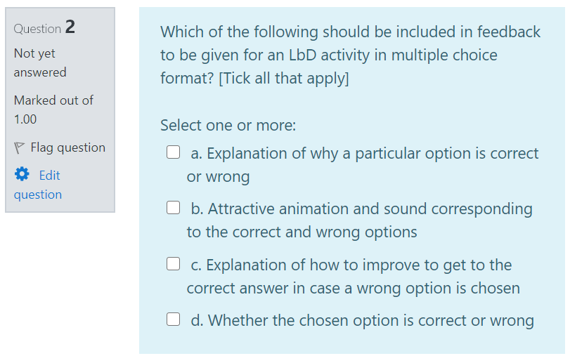
LbD Activity - Assimilation quiz: Giving customized feedback

Slide 49
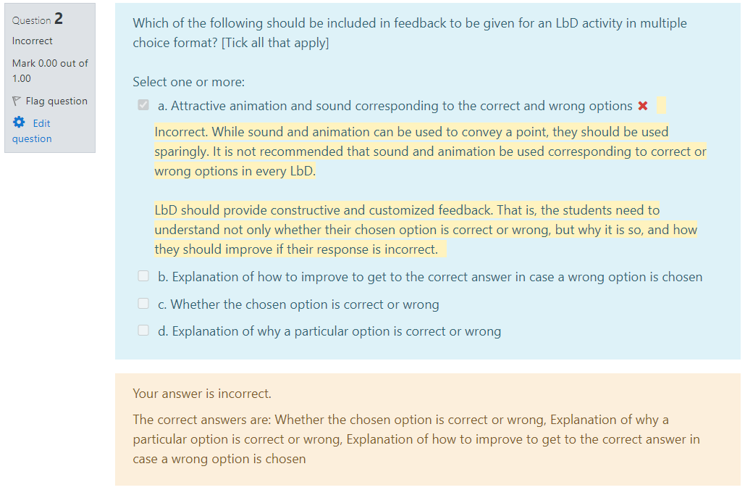
LbD Activity - Assimilation quiz: Giving customized feedback

Slide 50
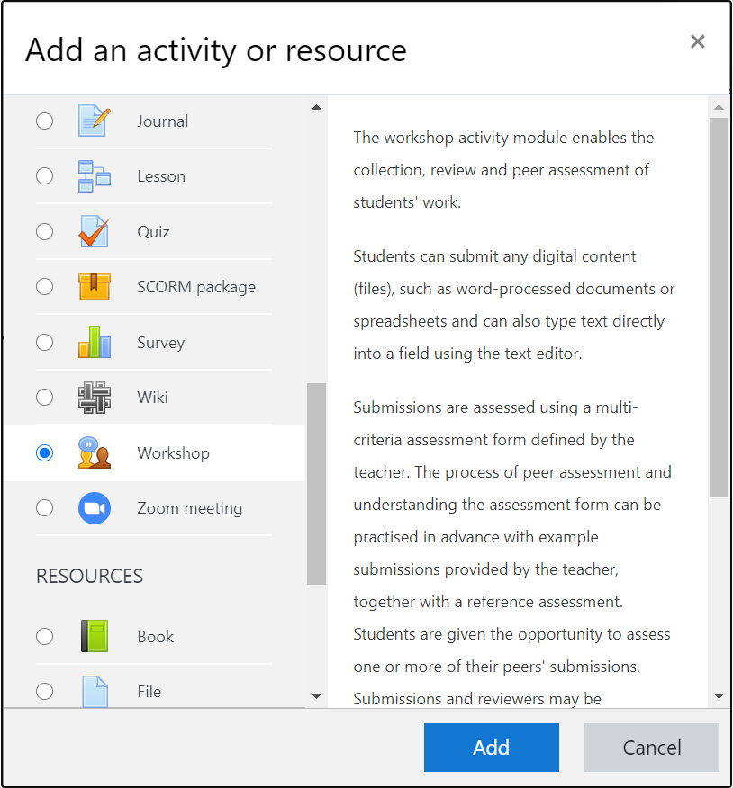
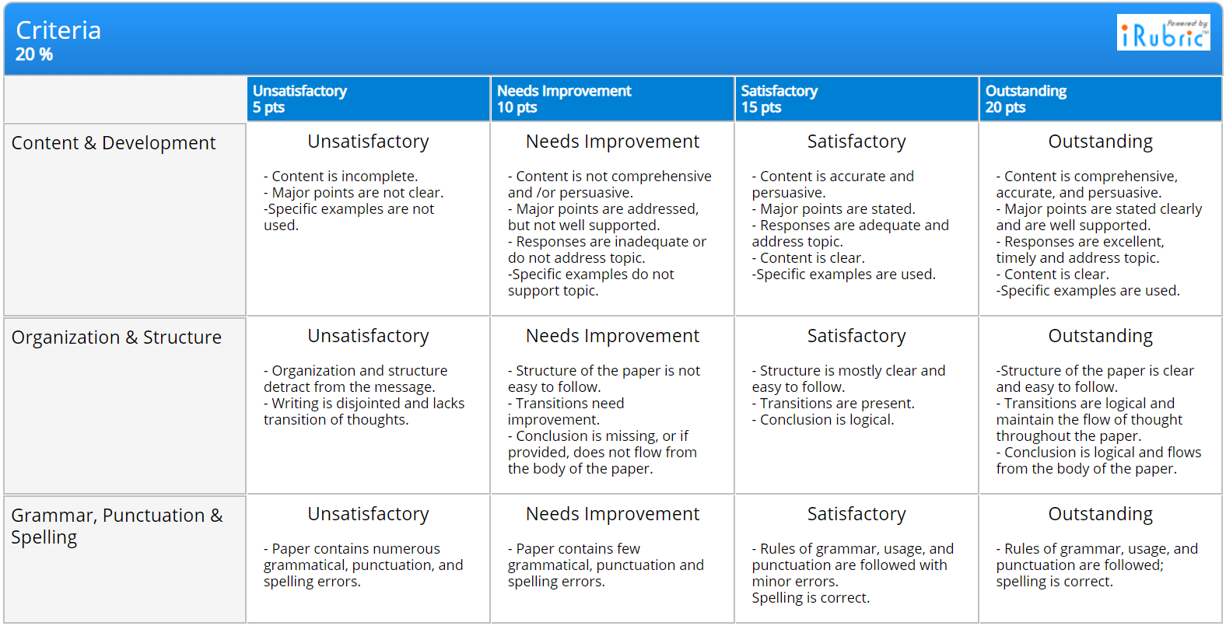
LbD Activities on Moodle - Example
Rubric for grading student responses to long answer questions - Grading criteria
Set of criteria
Description of performance levels

Slide 51
Technology Tools: Interacting with students

Slide 52
Interacting with students involves
Content creation or curation
Upload & share content
Design activities, provide
resources
Interact with students
Assess- ment
Conduct live interactions
Facilitate meaningful discussions in Forums
Set up Muddy points forum

Slide 53
Conducting live interactions
Online platform - Meet students synchronously
Establish personal connect with students
Only asynchronous interaction - May lead to isolation and disinterest
After giving students enough time - asynchronous materials
Live interaction is useful to address their doubts
Get feedback on content
Address questions systematically or do a tutorial (TAs/Instructor)
Ask students to post their questions in advance

Slide 54
How not to do live interactions?
Do not use it as primary mode of delivering content: Caution!!
Using it as ‘substitute’ for f2f is not effective
Access issues
Student engagement - Attention span, Distraction
Live lecture + Recording + Make it available to students
Large file size
No activities to actively engage students
Mantra! Not too many, Not too little - Do it periodically

Slide 55
Activity 4
You might have attended different talks, webinars, interaction sessions etc. in the last 2-3 months. And, due to that you might have got familiar with different video conferencing platforms such as Zoom, Webex, Google Meet, MS Teams etc.
List your top two features of such platforms which you think makes the live interactions most effective and engaging.
Go to www.menti.com and use the code 19 48 53
July 08, 2020 Educational Technology, IIT Bombay
Notes:
Looking at learners/camera
2. Instructor

Slide 56
Effective live interaction - Strategies and technology tools
Have a moderator
Chat, Hand raise, Poll (Yes/no questions, Thumbs up/down)
Encourage students to speak up or participate
Gather feedback from students
End by asking students to post muddiest points on chat
Address these on course platform by providing supplementary materials, if possible
Ask TAs to write summary of the key points for those who were unable to join
Video Conferencing Software

Slide 57
Effective live interaction - Strategies and technology tools
Mentimeter
Ask different types of questions or do activities during live interaction to
Encourage students to participate
Get an idea about students’ progress with asynchronous materials
Gauge in real time students’ level of understanding/ misconceptions
What types of questions?
MCQs, Yes/No, Polls, Word Cloud, …

Slide 58
Example - Conceptual MCQ using Mentimeter
Course: Fluid Mechanics Mode: Online Instruction
Week 1, Topic: Fluid Statics Asynchronous materials
Imagine holding two identical bricks under water. Brick A is just beneath the surface of water, while brick B is at a greater depth. The force needed to hold the brick B in place is ……… the force required to hold brick A in place.
larger than
same as
smaller than
See technique called Peer Instruction

Slide 59
Making decisions, Closing thoughts

Slide 60
Website walkthrough flashthrough
https://sites.google.com/view/iitb-teachonline/

Slide 61
There exist many many technology tools
Content creation or curation
Upload & share content
Design activities, provide
resources
Interact with students
Assess- ment
PPT, PDF, Whiteboard FlashBack Express, OBS, OpenShot, ShotCut
YouTube, Vimeo Moodle, Google classroom, Google sites
Moodle activities Google tools (Google classroom/ Google sites)
Zoom, WebEx Big Blue Button, Mentimeter Discussion Forum, Padlet
3rd party proctored exams, remote monitoring, ...
How do we select?
Notes:
Recommendations of specific technologies are not within the scope of this talk. See course page.

Slide 62
What to compare in technology tools?
Video creation – Video type, Ease of use, Rendering time, Filesize, …
Video hosting – Availability (anytime-anywhere), Security, Privacy, …
Activity creation – Ease of creation, giving feedback, Ease of doing, …
Platform – Ease of use for faculty and students, Support for learner-centric strategies, Grading and assessments, Analytics, …
Live interaction – Scaling, Sharing, Breakout rooms, …
…
Availability of tech-support - within Institute and elsewhere
Institutional policies
Notes:
Recommendations of specific technologies are not within the scope of this talk. See course page.

Slide 63
Time management
Content creation for online instruction takes at least 4X times as compared to the corresponding face-to-face class
Hence:
Curate resources
Give activities to assimilate the content
Get TAs to help with technology
Consult colleagues who have used the technology

Slide 64
Take-away
There is no single correct way of conducting online courses, just as in face-to-face teaching
It is not necessary for all faculty to have the same approach
Be aware of the trade-offs and take considered decisions, not to mimic face-to-face teaching as a default
It is sufficient if you start wherever you are comfortable and go up the levels gradually

Slide 65
Topics not covered in this talk
What to do about physical labs
How to incorporate Virtual Labs
How to conduct remote exams
What to do about proctoring
What about learning analytics
How to use analytics meaningfully
…

Slide 66
Over to Q & A
Please enter your questions into the chat window
Speak as directed by the moderator
Questions from this talk are on next slide

Slide 67
Questions discussed
From IISER Thiruvanathapuram Webinar, July 23
How many short videos would serve as equivalent for 1 hour f2f lecture?
Is having a group project good for peer learning?
What kind of assignments can be given for group learning?
Online or offline, teaching 200-400 students may be a difficult task. One way to overcome this problem is to use teaching assistants. For how many students would you suggest one TA?
Can online learning replace traditional schooling?
Which of the modes of presentation is the best for effective teaching?
Are there recommended tools for editing video and audio of you recorded video lecture !!
For students with poor or no connectivity, how LbD can be exercised effectively and provide feedback?
For assignment or exam, mathematics students need to write lots of questions, any suggestions in this direction?
There may be copyright issues when curating content. Pointers for handling/avoiding them?
What should be the ratio of asynchronous to synchronous mode of teaching per week?
Is there any way to do live drawing/writing as we do in the board
In mathematics, students has to write equations in their answers to assignment questions. How do we that?
What about the students who do not have good bandwidth?
Student may not have large local storage in their mobile devices. How to take care of this issues?
For some specific topics, doing live lectures is very important. So, why not to do live lectures?

Slide 68
Questions discussed
From IIT Kharagpur Webinar, July 28
How to get permission for reuse (of content if we are curating)?
Is there a possibility of your course getting diluted due to curation?
Are there any principles for creating activities for graduate level courses where research component is more?
In my own limited experience, i notice a quick drop in student participation in such discussion forums. is there a way to incentivize it (not via grading credit!:))
Is there any open source video tools in which we can embed quiz?

